Slide 1
Final PPT - Capstone
Supply Chain Project
Submitted by
Sundar Ram S
PGP DSBA –ONLINE DEC_C 2021
Notes:
Good Morning Sir,
I am here to present my Final Capstone project of PGP DSBA on Supply Chain

Slide 2

AGENDA
Problem Definition & Objective
Approach
Insights & Recommendations
Notes:
We will look on what the problem definition is and it objective.
Approach followed to achieve the objectives & insights & receommendations to improve bottom line

Slide 3



PROBLEM DEFINITION
Miss-Match in the demand and supply of Noodles
High Demand – Low Supply & Low Demand – High Supply
Inventory cost loss to the company
Notes:
A FMCG company has entered into the instant noodles business two years back. Their higher management notices that there is a miss match in the demand and supply. Where the demand is high, supply is pretty low and where the demand is low, supply is pretty high. In both the ways it is an inventory cost loss to the company.

Slide 4






OBJECTIVE
Optimization of Supply Quantity in all ware houses
Determining optimum weight to be shipped
Analyze demand patterns
Boost sales/ bottom line through targeted campaigning
“80% of the cost is accommodated by only 20% of the products”
Notes:
hence, the higher management wants to optimize the supply quantity in each and every warehouse in entire country. Inventory management is an important aspect in managing supply chain. Understanding and the ability to determine demand and supply pattern will aid effective management of the inventory, regulating/ optimizing storage quantity based on demand & supply, thus keeping a check on the total inventory cost from increasing.
As the saying goes – “80% of the cost is accommodated by only 20% of the products”, it becomes need of the hour to classify & manage inventory.
The analysis will also help in targeted campaigning in each region that helps boost the sales and profits.

Slide 5






APPROACH
Model Building & Tuning
Data Visualization
4
Data Cleansing
2
1
5
3
Insights & Recommendations
Feature Selection
Notes:
The approach followed was first to clean the data, followed by Data Visualization & Feature selection. Various regression models are then built. Insights from EDA & Models are summarized, analysed and suitable recommendations are made.

Slide 6

DATA OVERVIEW
S.No | Variable Name | Data Type
1 | Ware_house_ID | Object
2 | WH_Manager_ID | Object
3 | Location_type | Object
4 | WH_capacity_size | Object
5 | zone | Object
6 | WH_regional_zone | Object
7 | num_refill_req_l3m | int64
8 | transport_issue_l1y | int64
9 | Competitor_in_mkt | int64
10 | retail_shop_num | int64
11 | wh_owner_type | Object
12 | distributor_num | int64
13 | flood_impacted | int64
14 | flood_proof | int64
15 | electric_supply | int64
16 | dist_from_hub | int64
17 | workers_num | float64
18 | wh_est_year | float64
19 | storage_issue_reported_l3m | int64
20 | temp_reg_mach | int64
21 | approved_wh_govt_certificate | Object
22 | wh_breakdown_l3m | int64
23 | govt_check_l3m | int64
24 | product_wg_ton | int64
Total Records – 25K
Total Variables – 24
Total Cells – 6L
23 Independent Variables
1 dependent Target Variable
14 int64, 8 object type & 2 float64 variables
Notes:
Before getting on to the cleansing part, this is just to give an overview of the data.
There are a total of 25000 records with 24 variables (23 Independent & 1 dependent) out of which 14 are integer, 8 object & 2 float type variables

Slide 7
DATA CLEANSING
Null Values
Outliers
Feature Engineering
Count: ~ 13.8 K (2% of the dataset)
Values abnormally away from the other values – Count: ~ 1.6 K (0.2% of the dataset)
Addition of New variables – Age of the Ware house – Added based on the wh_est_year
Most ML Algorithms don’t work & Leads to Biased Models giving incorrect results
Lack of Precision in Statistical Analysis
Treated Using Forward Fill Technique
Affects arithmetic mean of the continuous variables & skews the value to one side
Visualized using Box Plot
Treated by imputing the max and min values
Variable Transformation – Binning of Age & Weight variables
Feature Engineering helps better Analysis & also sometimes better model building
990 - workers_num
11881 - wh_est_year
908 - approved_wh_govt_certificate
948 - retail_shop_num
631 - workers_num
Maximum = [Q3 + 1.5(IQR)]
Minimum = [Q1 - 1.5(IQR)]
Variables | Minimum | Maximum
workers_num | 10.5 | 46.5
retail_shop_num | 2532.5 | 7280.5
Ware_house_ID & Manager_ID are dropped as they are mere identification numbers and don’t add any value to model building
Notes:
Data cleansing here, essentially consists of 2 parts. Treatment of Null values & outliers. On evaluation it can be seen that 2% of the dataset are null values that gets contribution from Warehouse establishment year, number of workers & certification of warehouse. Null values lead to biased models giving incorrect result, so we treat these null values using the Forward fill method, that fills the null value with the previous value of the same variable.
In the case of the outliers, it contributes to 0.2 % of the entire dataset. Which skews the values towards one side. Hence for treatment, we use the regular method of imputing the outliers with min and max values whichever applicable. We can see that outliers are present in number of workers and retail shops. The max an min are 75th percentile plus 1.5 times the inter quartile range & 25th percentile minus 1.5 times the inter quartile range.
We also tried to engineer features so as to give a better perception of the data. The ages and weights were binned in to categories
Finally the (read red part)

Slide 8
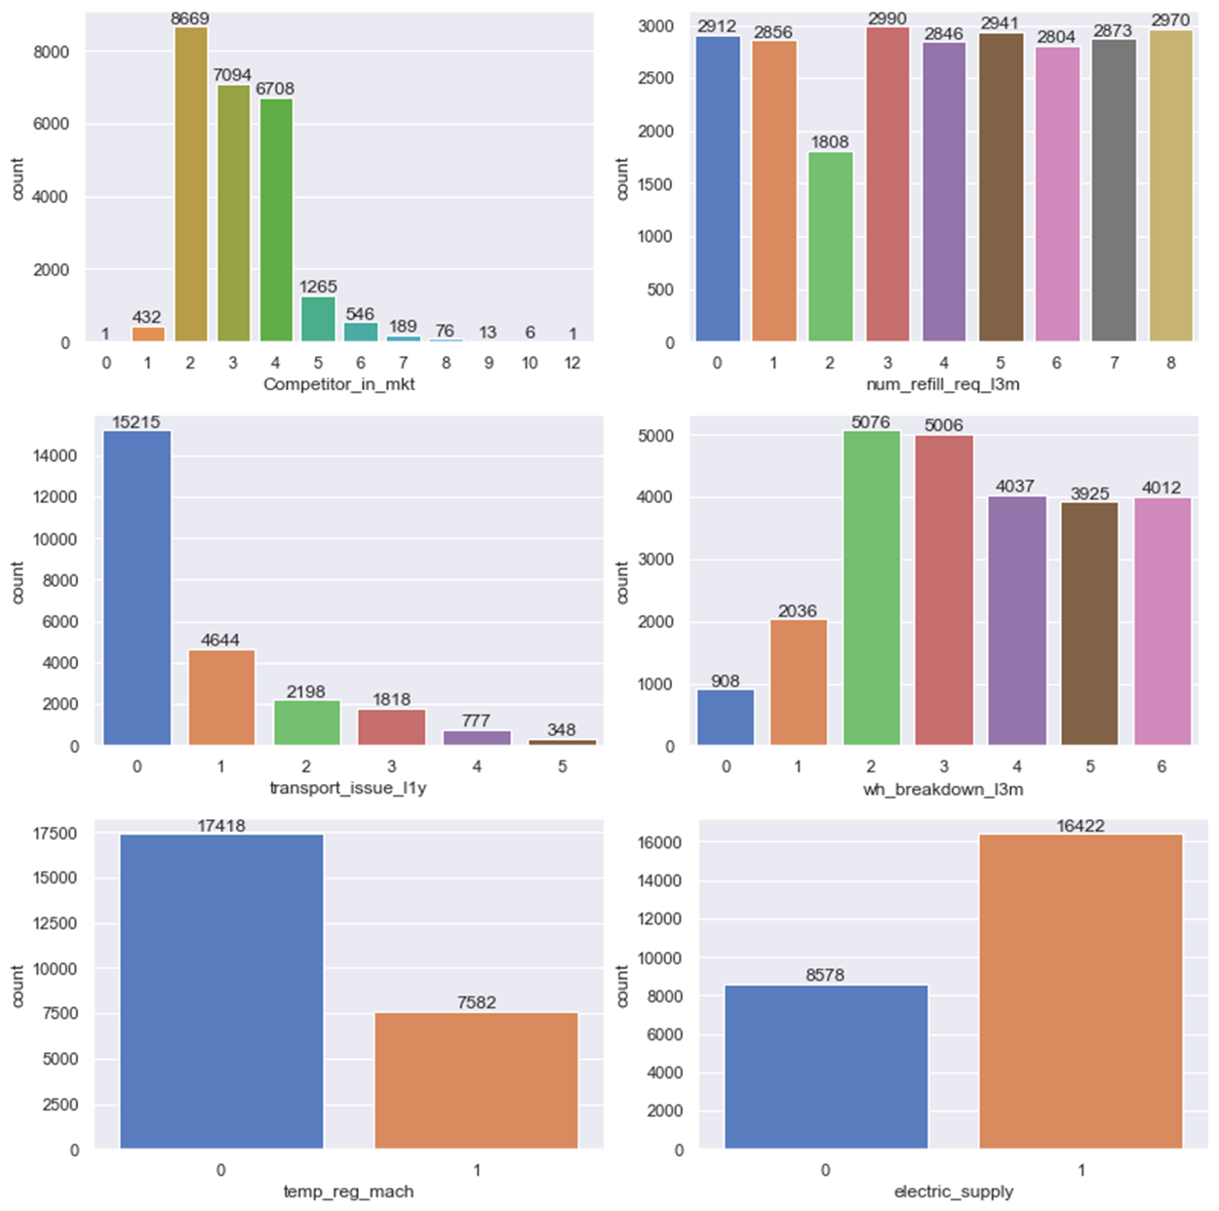
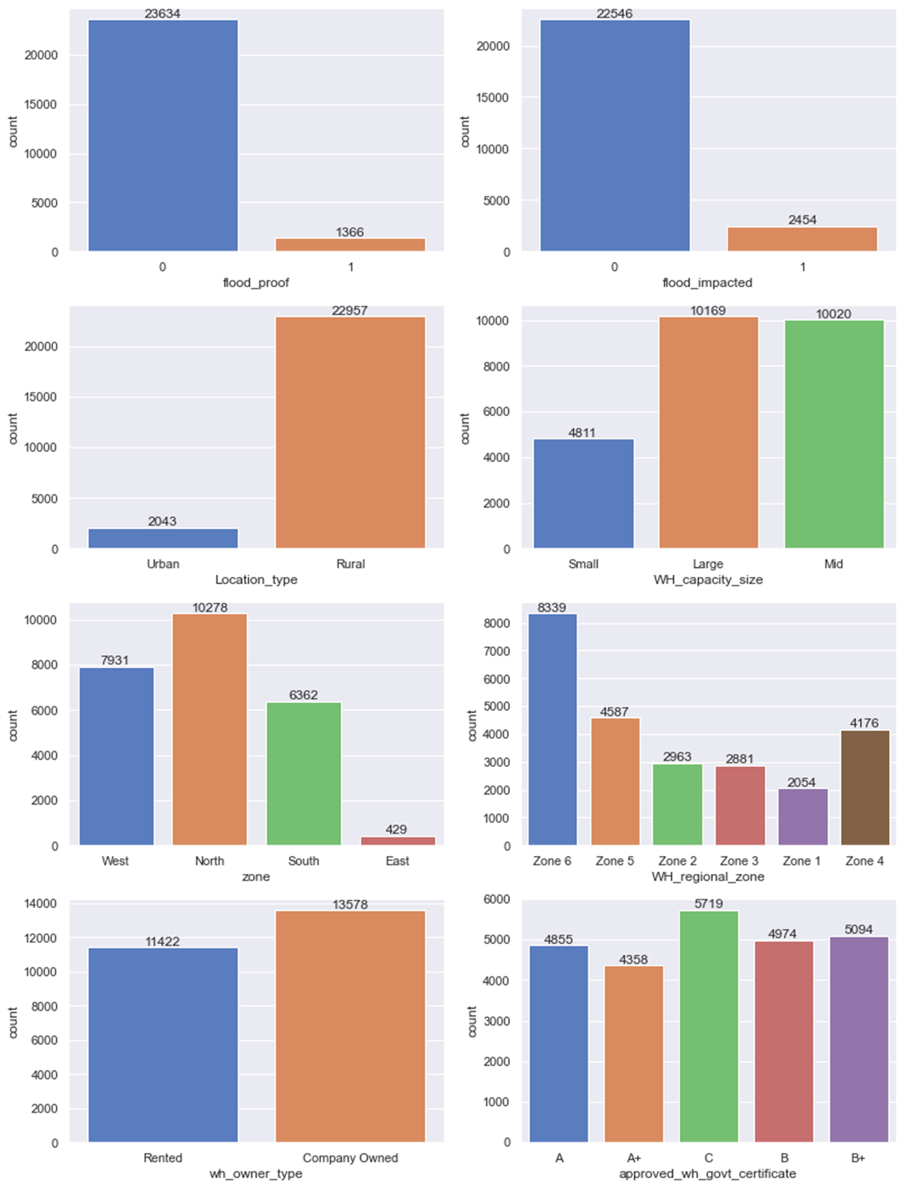
DATA VISUALIZATION
Notes:
Post cleaning , we get in to the visualization part.
We can see that most of the ware houses had 2 competitors in market, while 1 ware house (WH_106813 ) did not have any competitor and 1 warehouse (WH_101568 ) had 12 competitors.
Most of the ware houses required 3 refills in the last 3 months, did not face any transport related accidents in the last 1 year, had 2 break downs in the last 3 months, does not have temperature regulating machine indicator
But have electric backup like generator.
Most of them are not flood proof and are also not located in flood impacted area.
Most of the ware houses are in rural areas, large and mid-sized and are accumulated mostly in the northern region and are in Zone 6.
The ware houses ownership are mostly company owned and are established in the year 2000.
The warhouses have mostly received C certification frrm government followed by B+, B, A & A+

Slide 9
DATA VISUALIZATION – CONTD…

Slide 10
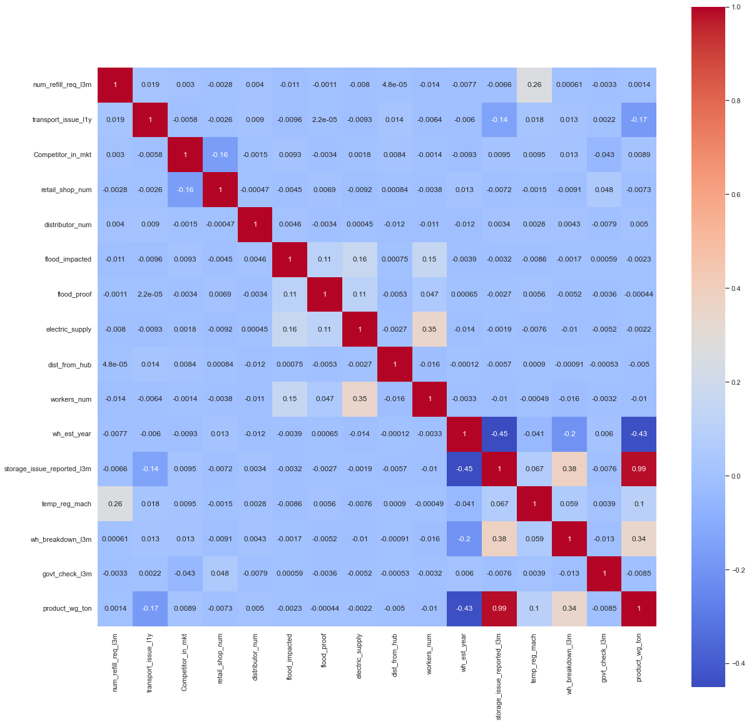
DATA VISUALIZATION – CONTD…
Presence of Multi collinearity
Indicates presence of correlation amongst independent variables
Undermines the statistical significance of an independent variable
Requires Suitable treatment

Slide 11
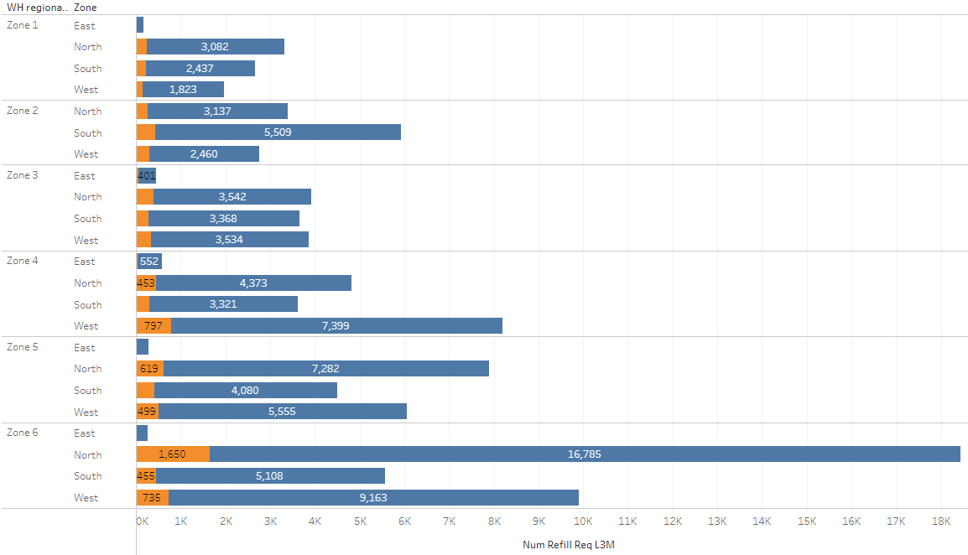


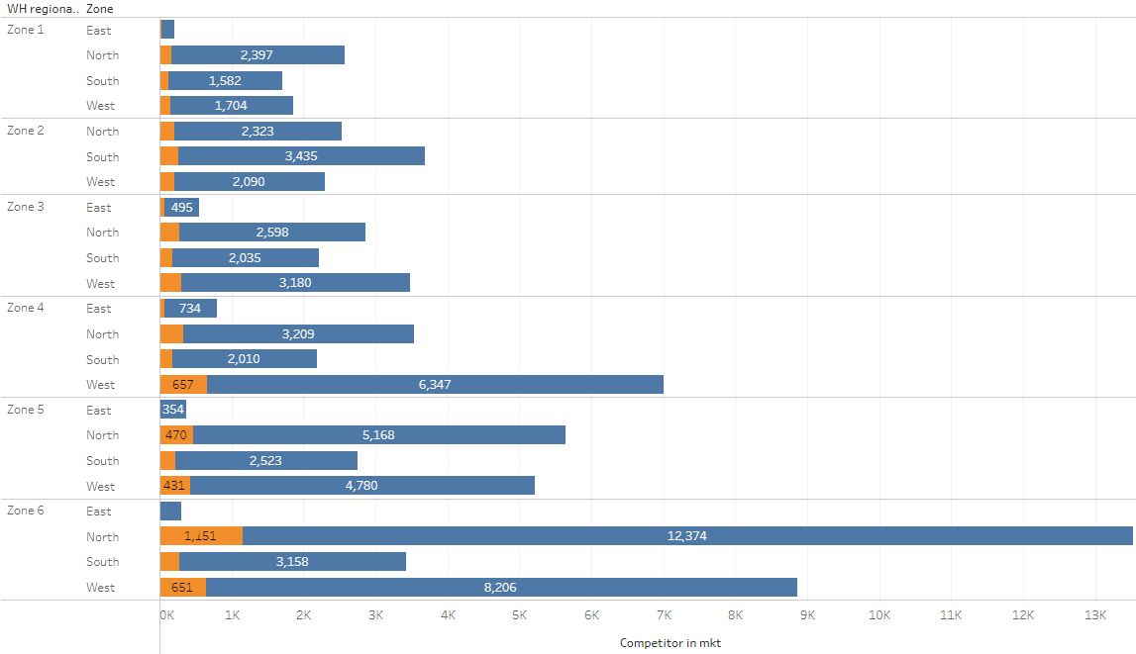
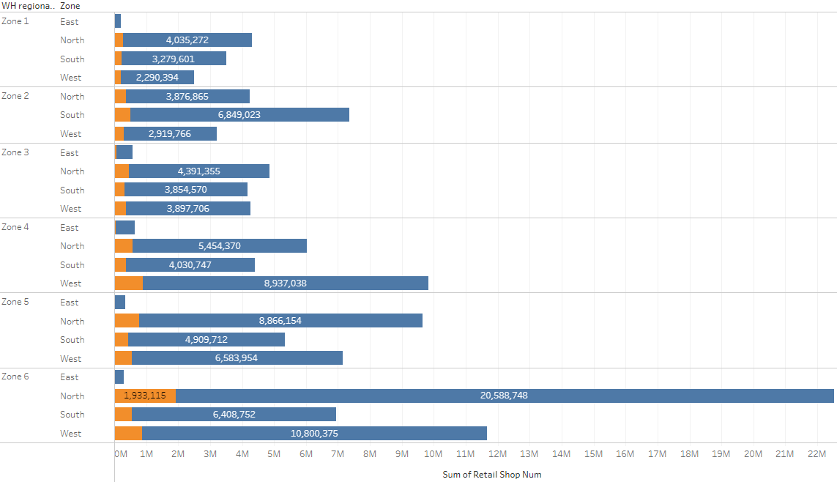
No. of Refills
Transport issues
No. of Competitors
No. of Retail shops

Slide 12

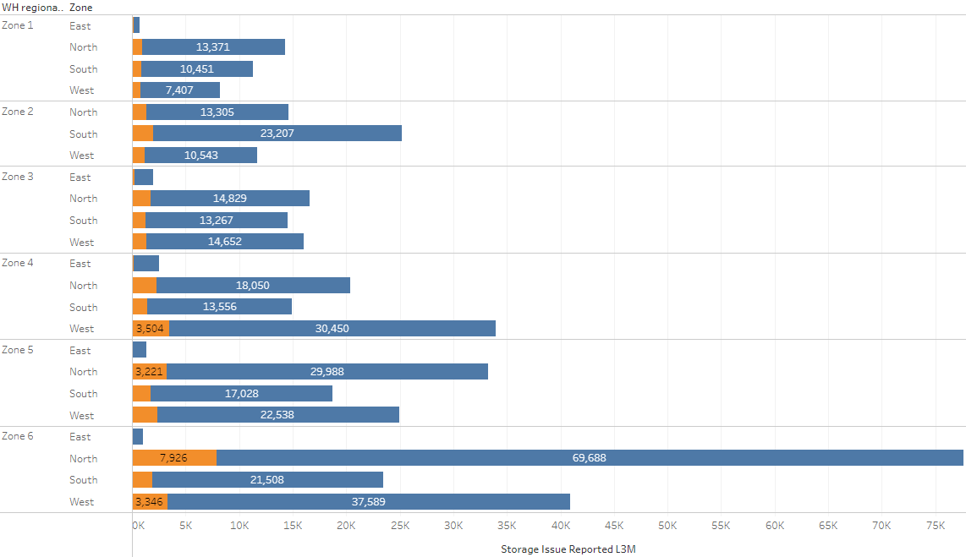

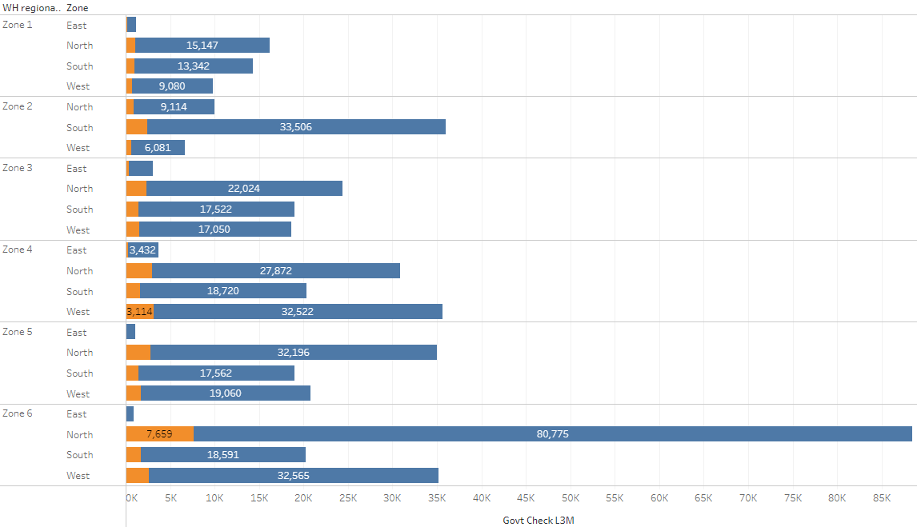
No. of Distributors
Storage issues
Breakdowns
No. of Govt. checks

Slide 13

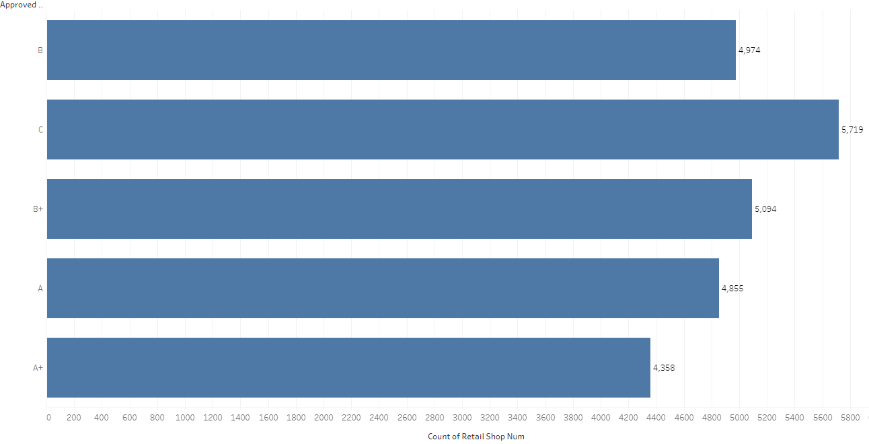
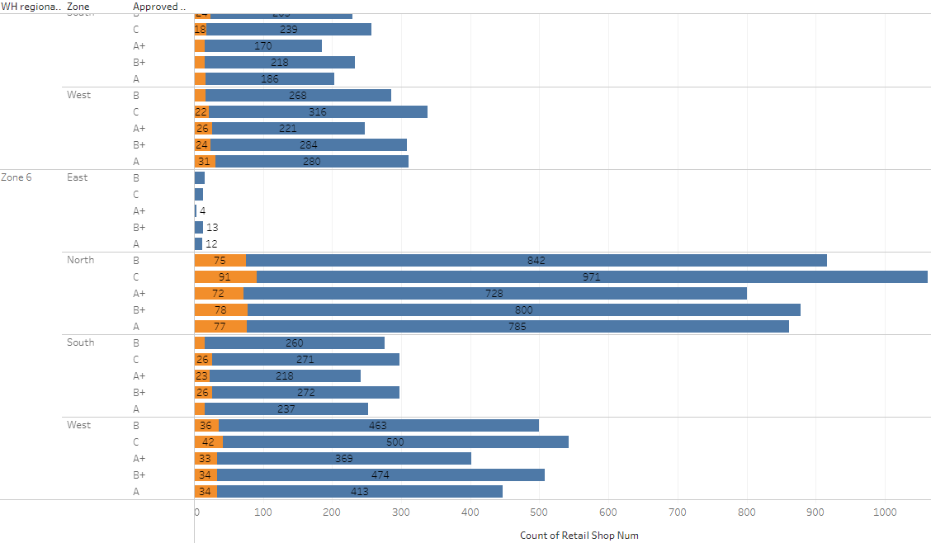
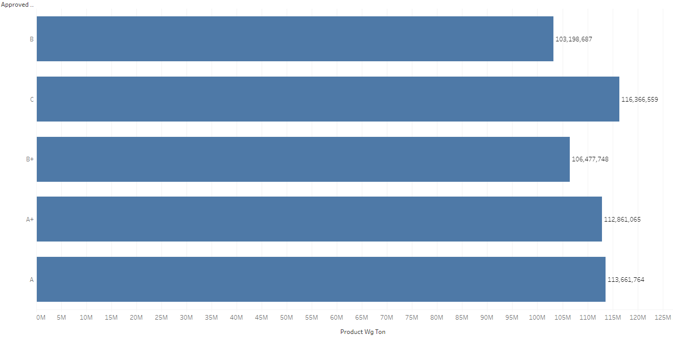
No. of WHs with Electric Backup
WH Certification Category

Slide 14
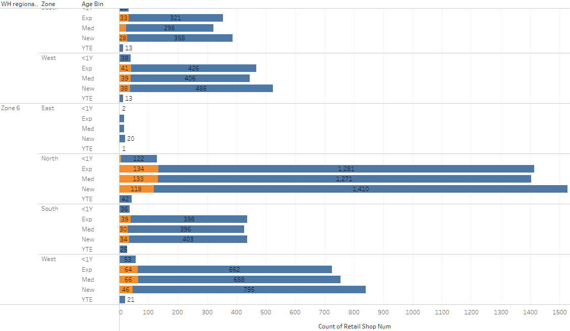
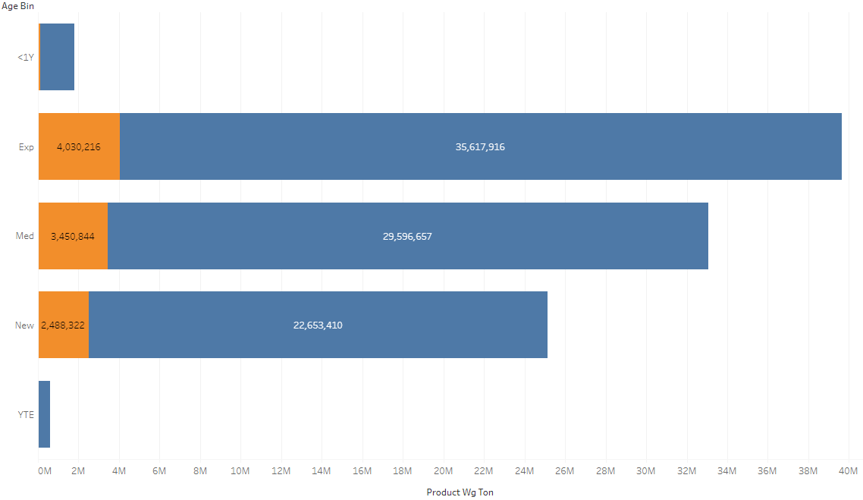
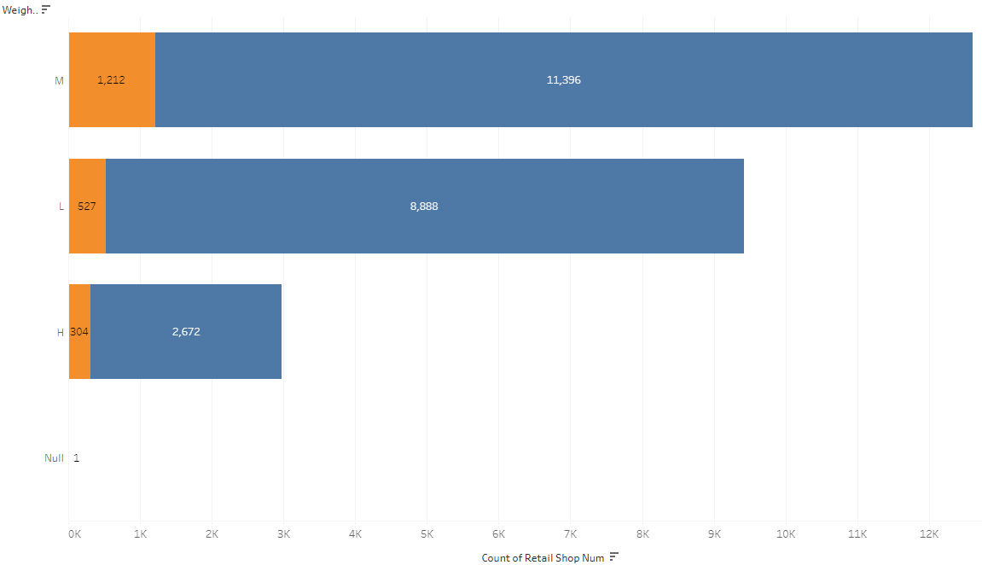
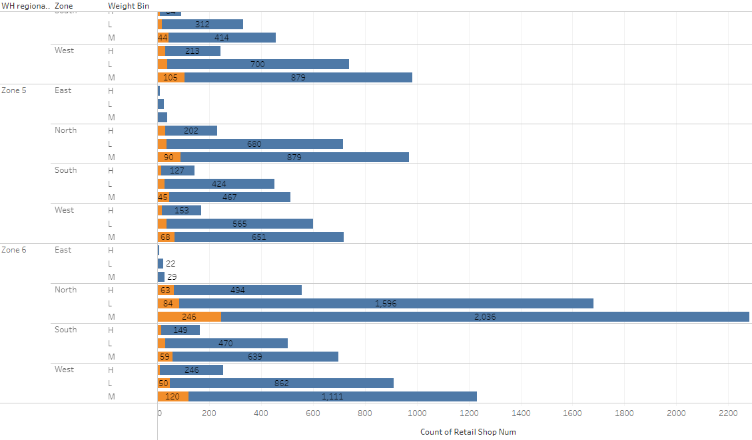
Age wise Wight of Inventory in WHs
Zone 6 - North
Age wise No. of WHs
Zone wise Weight Category wise No. of WHs
Weight Category wise No. of WHs
Notes:
we can see that most of the Ware houses are in the New age bracket (1 to 9 years) and are mostly concentrated in the Northern region of Zone 6.
in spite of more number of ware houses in the new category of Zone 6, northern region, it is Expert category ware houses that has the capacity to hold more number of weight and in turn indicates that it has developed a huge customer base that more weight is stored followed by Med & New.

Slide 15

Insights from EDA
Multi collinearity present in the data – Correlation Plot
Warehouses in the Northern region & rural location type of Zone 6 are the most prominent
Most of the Warehouses are C certified & carry medium category weight
Most of the Ware houses are new but the customer base is strong for expert category Warehouses
Recommendations from EDA
Analysis of market requirement
Planning of warehouse inventory
Timely Introduction of new products
Targeted marketing & Strategic Pricing
C to A+ certifications conversions

Slide 16
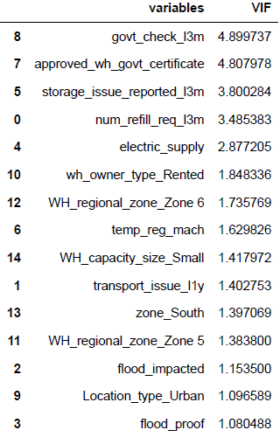
FEATURE TRANSFORMATION & SELECTION
Encoding of Object type variables – One Hot Encoding & Dummy Encoding
Multi collinearity treatment through Variance Inflation Factor method
Measure of how much the variable is contributing to the standard error
A value of up to 5 for VIF is allowed.
The variables with a VIF above 5 are removed one by one and the VIF is recalculated after each removal.
14 FINAL SIGNIFICANT VARIABLES

Slide 17

Model Building
Supervised Regression Problem
Predict any value between 0 to + infinity for weight
Model Description
Linear Regression
Decision Tree Regressor - CART
Ensemble models
Models for Regression Problems
Adaboost
Gradient boost Regressor
Random Forest Regressor
Bagging
Train the model using train data and test using test data
Separation of Dependent & Independent variables.
Split data in to Train & Test data (70:30)
Train Test Split

Slide 18
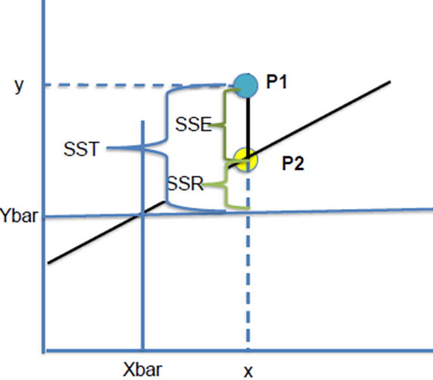
LINEAR REGRESSION
Linear combination of the explanatory variables
An expression of one or more variables scaled by a constant factor and added together
Dependent variable value = (weight ∗independent variable) + constant
It is the straight line in the scatter plot of the variables
The best fit line can be found out using the Gradient Descent method
Linear Regression models are built using SKLEARN & SCIPY STATS in Python
Model Definition & Building Approach
Y = m1X1+ m2X2+ ….. + mnXn+ C + e
Predictive power
Residual error
P1 | Original y data point for given x
P2 | Estimated y value for given x
Ybar | Average of all Y values in data set
SST | Sum of Square error Total (SST), Variance of P1 from Ybar (Y Ybar )²
SSR | Regression error (p2 ybar ) 2 (portion SST captured by regression model)
SSE | Residual error (p1 p2)²
Errors & Metrics in linear regression model
Best Fit line, SSE = 0 => SSR/ SST =1
R² = SSR/SST (Coefficient of Determination)
R² tends to 1
Lower the RMSE better the model
Train & Test model
The model is initialized using the specific library
Train data is fit in to the model & model gets trained for predictions
The model is tested using test data and the metrics R² & RMSE are evaluated

Slide 19
DECISION TREE REGRESSOR
CART – Classification And Regression Tree is a binary decision tree
Gives both categorical & continuous output
Nodes are split based on the least mean squared error for regression
Model is built using the SKLEARN library in Python
Errors, Metrics, training & testing models remain the same as in linear regression model.
Model Definition & Building Approach
Decision Tree Regressor function is called and initialized with certain hyper parameters
Hyper parameters determines the way the nodes are split and their criteria
Criterion – Squared error is the split criterion (for regression models)
Maximum depth - number of branches that the tree can be split along vertically
Min sample leaf - minimum number of records that a node must contain after splitting
Min sample split - minimum number of records that a node must have so that it can be split
The model is built for default parameters & further tuned to avoid over fitting (Exceptional in train data, while fails in test data)
Hyper Parameters
Grid search cross validation-
Grid search - technique to select the best ML model, parameterized by a grid of hyper parameters
Cross validation – splits dataset into random groups, holding one group as test, and training the model on the remaining groups
Process is repeated for each group being held as test, then the average of models is used for the resulting model.
Model Tuning

Slide 20
RANDOM FOREST REGRESSOR
Ensemble technique - multiple CART models are built to get the accuracy in the predicted value
Model building is same except that we need to build a Random Forest Regressor model instead of Decision Tree Regressor
Errors, Metrics, training & testing models remain the same as in the other two models
Model tuning is same as in that of the Decision tree regressor
Model Definition, Building Approach & Tuning
Same as that of DT Regressor
Some additional hyper parameter include Max_features (no. of independent variables to be considered) and n_estimators (no. of DTs to be built)
The model is built for default parameters & further tuned to avoid over fitting
Hyper Parameters
BOOTSTRAP AGGREGATING
A technique of sampling - creates sub sample of observation with the actual dataset, with replacementme
Reduced chances of over fitting
Self imposed Model tuning - trains a large number of “strong” learners in parallel & combines to "smooth out" predictions
Model is built using the Bagging Regressor of SKLEARN in python
Model initialization includes defining the model over which the Bagging has to happen. In this case it is the RF Regressor
Model Definition & Building Approach

Slide 21
BOOSTING
Linear sequential process - model minimizes errors by learning from previous model predictions
Large number of weak learners trained sequentially – Combines to forma a strong learner
Two types of boosting – Adaptive/ Ada boost & Gradient boosting
Successive learners are created with a focus on the ill fitted data of the previous learner
Adaboost Regressor library of Sklearn is used to build the model
Initialized with number of Decision trees
Ada Boost
Each learner is fit on a modified version of original data
New models are fit to the residuals
The overall learner improved where the residuals are high
Gradient boosting Regressor library of Sklearn is used to build the model
Gradient Boost
Notes:
Bagging uses complex models and tries to "smooth out" their predictions, while Boosting uses simple models and tries to "boost" their aggregate complexity.

Slide 22

Model Results & Insights
Gradient boosting has the least RMSE in test data & RMSE has decreased for testing data
Implies the least possible inventory cost loss
Aids in pre-planning and specific campaigns
Boost sales which aids to further boosts the bottom line of company.

Slide 23


BUSINESS RECOMMENDATIONS
Gradient boosting can be deployed for predictions as it has the least RMSE in test data & RMSE has decreased for testing data
Analysis of market requirement in Northern region, rural location of Zone 6
Proper planning of warehouse inventory
Timely introduction of new products
Targeted marketing based on demography & Strategic Pricing
C to A+ certifications conversions of all the warehouses in turn developing the customer base

Slide 24
Thank You

Slide 25
APPENDIX

Slide 26
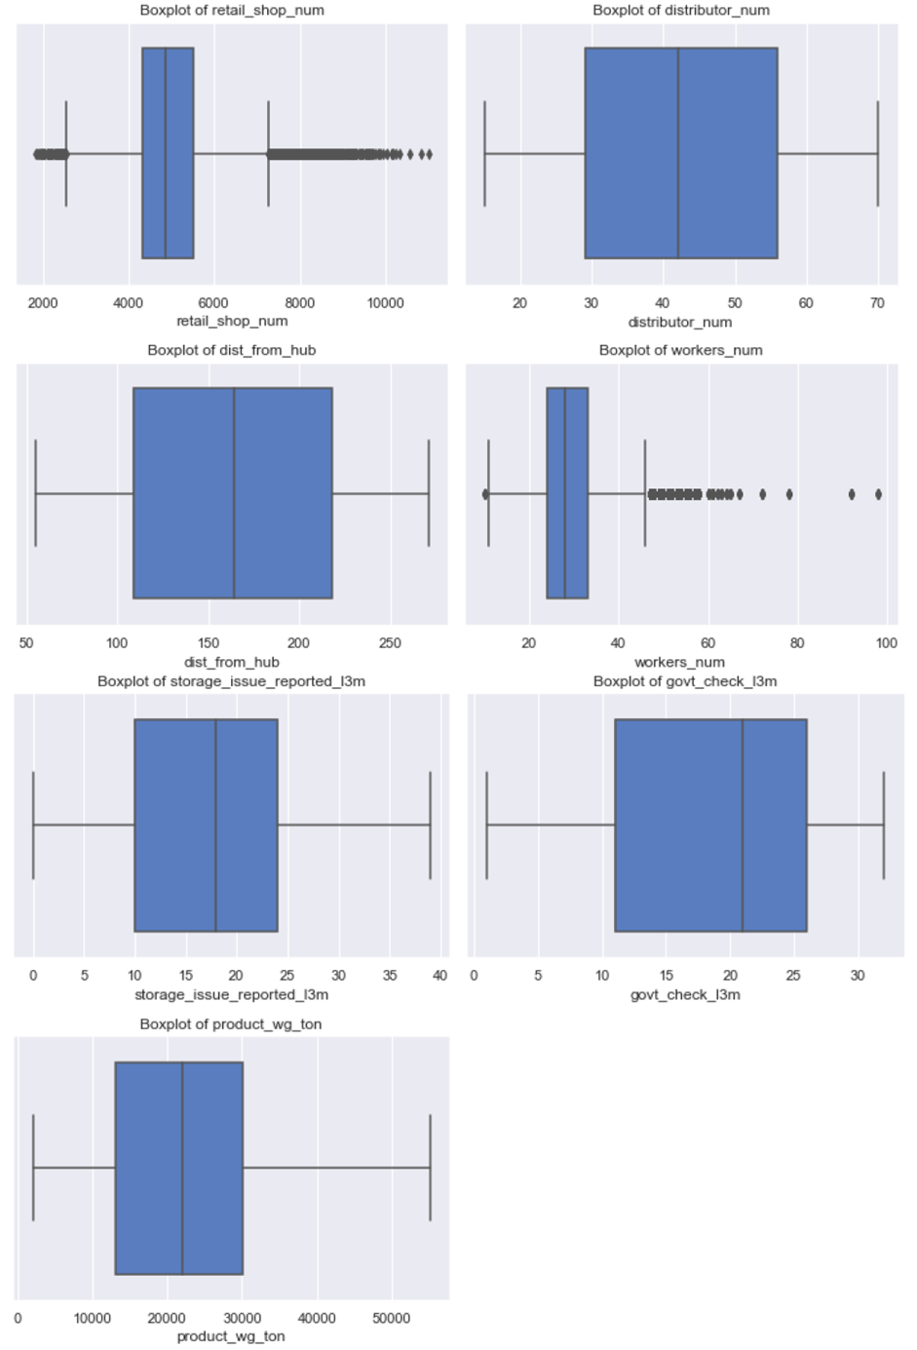
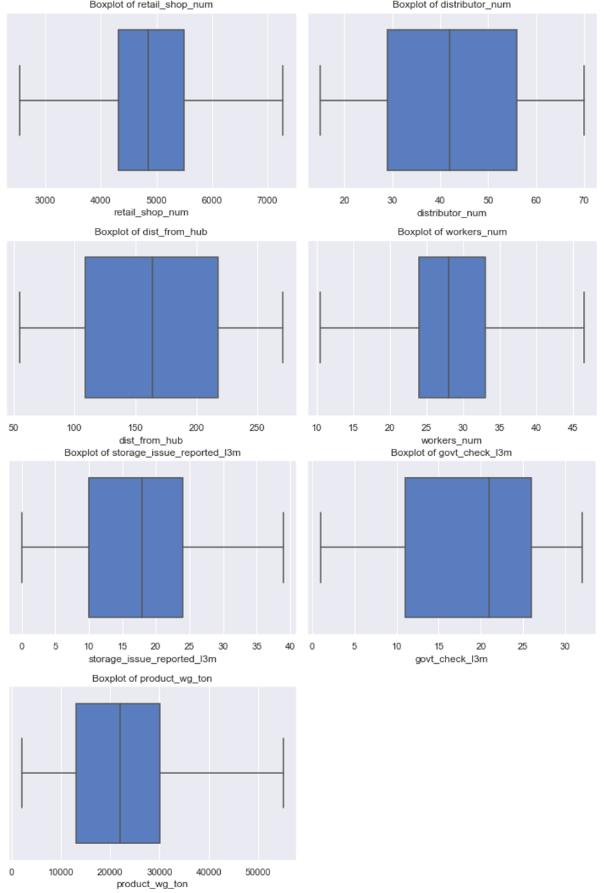
Appendix 1
BEFORE
AFTER

Slide 27
Appendix 2
Age Bins | Description
-1 | Yet to Establish
0 | Less than 1 year
1 to 9 | New
10 to 17 | Mediocre
18 to 26 | Expert
Weight Bins | Description
2065 to 17695.33 | Low
17695.34 to 35390.67 | Medium
35390.68 to 55151 | High

